Slide 1

Four Step Process
Reading: 0.2
exercises: All chapter 0
Assigned: hw 1
Producer: dr. mario
img credit: alex riegert-waters

Slide 2
Four Steps of Statistical Modeling
Choose a form for the model
Fit that model to the data
Assess how well the model fits the data
Diagnostic Plots
Look for Patterns in the Residuals
Check Assumptions (Randomness, Independence, Normality)
Use the model to answer questions

Slide 3
Supplement for Lecture 2
Download Zip Folder on Course Website for Supplement
Unzip Folder on Your Computer
Open the Template.rmd File from the Unzipped Folder
Install Mosaic Package and Stat2Data Package
Run First Two Code Chunks and View Dataset

Slide 4
Example: LEGO
Variable of Interest: Amazon_Price
Question of Interest:
How well can we predict the price of a LEGO set on Amazon without knowing any other information?

Slide 5

Form of Model
Constant Model:
The constant c is called a parameter
We use data to replace the unknown c with a sample estimate $\hat{c}$

Slide 6


Fitting the Model to Data
For the constant model, if we want to estimate Y, then
The predicted y is denoted $\hat{y}$.
Good choices for $\hat{c}$
Sample Mean: $\hat{c}= \overline{y}=\frac{\sum{y_{i}}}{n}$
Sample Median: $\hat{c}=m_{Y}$
$$\hat{y}=\hat{c}$$

Slide 7
Assess Fit of Model
Question: Is the model good and which estimator is better?
Calculate residuals for each observation in data
Each observation has a residual so how do we summarize the overall fit?
$$residual=\hat{ε}=y −\hat{y}$$

Slide 8

Assess Fit of Model
Criteria for Assessing Fit (Loss Functions)
Sum of Errors:
Sum of Squared Errors (SSE):
Sum of Absolute Errors (SAE):
$$∑(y−\hat{y})$$
$$∑{\left(y−\hat{y}\right)}^{2}$$
$$∑|y−\hat{y}|$$

Slide 9
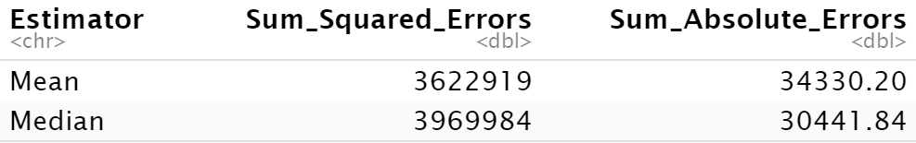
Supplement for Lecture 2
Subset Data to Remove Missing Values
Estimate Constant Using Sample Mean and Sample Median
Assess Fit of Both Models Based on Two Different Criteria

Slide 10
Example: LEGO
Follow-up Question: Is there a relationship between the theme and the price on Amazon?
Alternative: What effect does the theme of the LEGO set have on the Amazon price?
Strategy for Analysis: Calculate the average price of different themes on Amazon and compare them. Look for statistically significant differences.

Slide 11
Supplement for Lecture 2
Mosaic package in R
Use of “formulas” in R to express models
Use of data=_______ argument to specify dataset and eliminate the need to call variables using data$variable
Has “modified” versions of classic functions that allow us to look at the effect a categorical variable has on a numeric variable
$$y\sim x_{1}+x_{2}+⋯+x_{p}$$

Slide 12

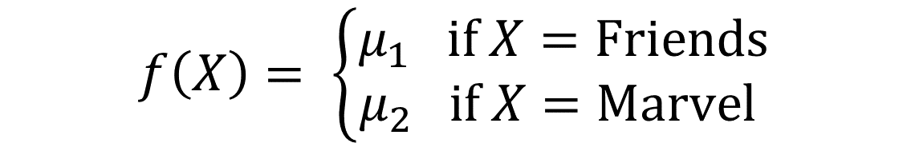
Model with a Binary Predictor
Where
and
$$Y=f\left(X\right)+ϵ$$
$$f\left(X\right)= \left\{\begin{matrix}μ_{1} if X=Friends \\ μ_{2} if X=Marvel \end{matrix}\right.$$
$$μ_{1}=Mean Price for Friends$$
$$μ_{2}=Mean Price for Marvel$$

Slide 13


Two-Sample t-Test for Difference in Means
Hypotheses (Non-directional)
Test Statistic
$${H_{0}:μ}_{1}=μ_{2}$$
$${H_{a}:μ}_{1}≠μ_{2}$$
$$t^{∗}=\frac{\overline{x_{1}}−\overline{x_{2}}}{\sqrt{{s_{1}^{2}}/{n_{1}}+{s_{2}^{2}}/{n_{2}}}}$$

Slide 14
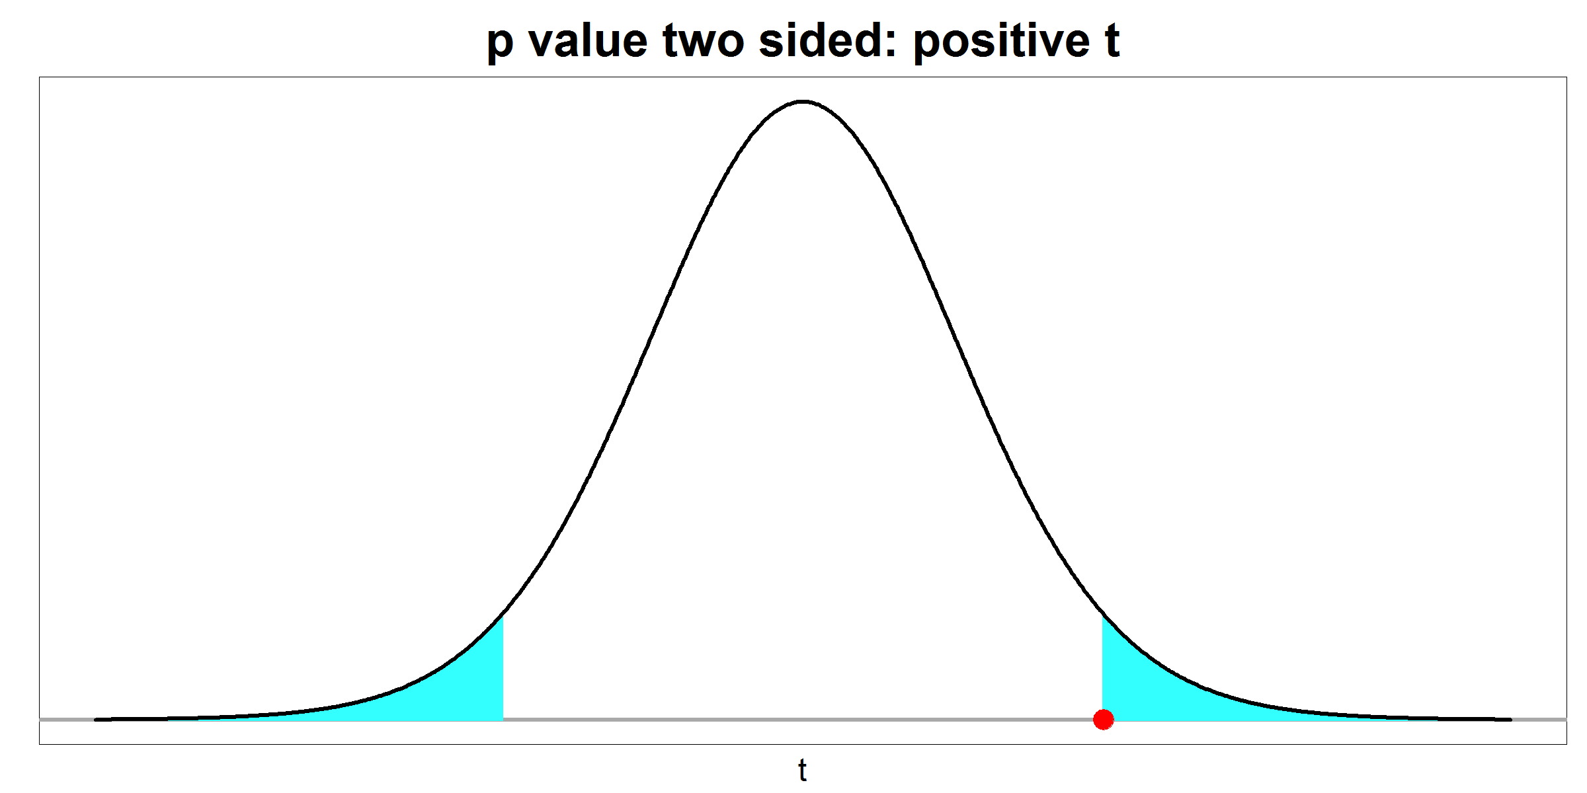
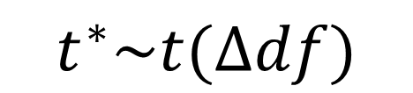



Two-Sample t-Test for Difference in Means
Calculate P-Value Using t-Distribution
Make Decision
P-value < 0.05, then Reject Null and Accept Alternative
P-value > 0.05, then Fail to Reject the Null
Interpret Results in the Context of the Problem/Data
$$Δ=\frac{{\left[{s_{1}^{2}}/{n_{1}}+{s_{2}^{2}}/{n_{2}}\right]}^{2}}{\frac{{\left({s_{1}^{2}}/{n_{1}}\right)}^{2}}{n_{1}−1}+\frac{{\left({s_{2}^{2}}/{n_{2}}\right)}^{2}}{n_{2}−1}}$$
$$t^{∗}\sim t(Δdf)$$
$${−|t}^{∗}|$$
$${|t}^{∗}|$$

Slide 15
Supplement for Lecture 2
Welch’s Two-Sample t-Test
Assume 2 Independent Simple Random Samples from Normal Dist.
Don’t Assume that Populations Have Equal Variances
Interpretation of p-value: Assuming the null hypothesis is true, the p-value measures the percent of all possible test-statistics that are more extreme than the one we observed (Ex: -1.185)
Assess Validity of Assumptions

Slide 16
Thank You
Make Reasonable Decisions

